Slide 1

Gene Set Enrichment Analysis (GSEA)

Slide 2
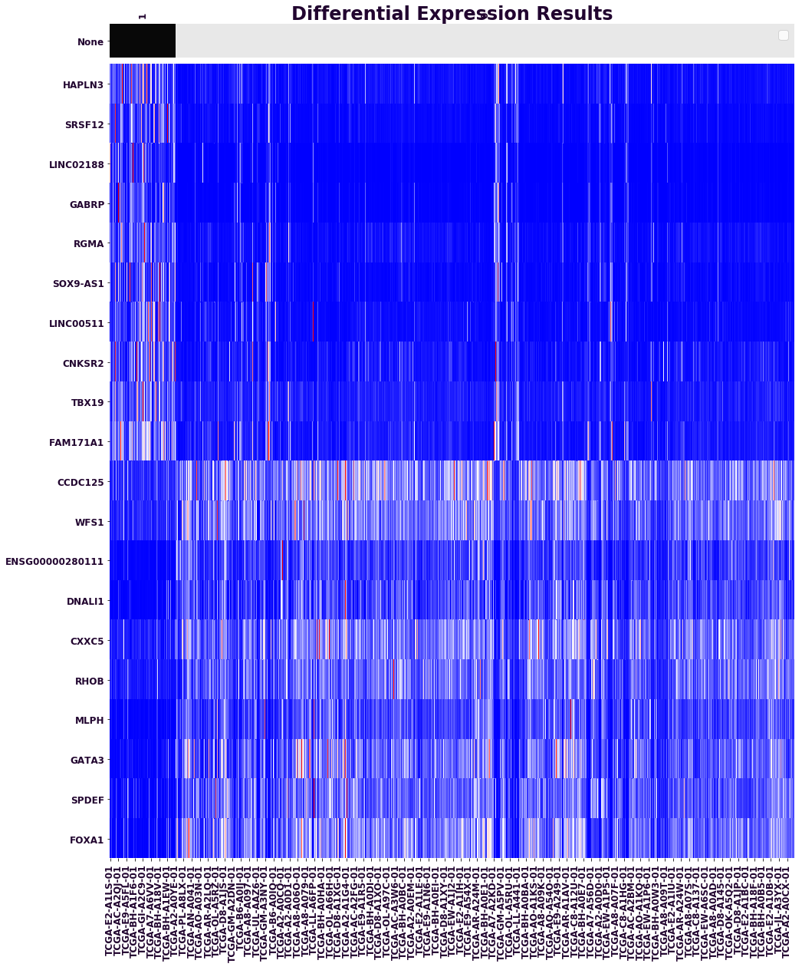
GSEA in a Nutshell
GSEA answers the questions “what are the gene sets that are significantly enriched in my data?” and “How enriched is my set of interest?”
E.g., are the genes mentioned in a paper enriched as a set in a particular phenotype?

Slide 3
GSEA Outline
Take gene expression data from two different groups and rank all genes according to the differential expression across the groups.
Take a predefined group of genes and determine whether they are differentially expressed as a set => called enrichment.
Randomly swap the gene-set or phenotype labels of the data and repeat the test many times as a gauge of significance of the enrichment analysis results.

Slide 4
GSEA Minimum Inputs
1 GCT file (Gene Expression)
1 CLS file (Phenotypes)
1 GMT/GMX file (gene sets)
Alternatively choose from online database
Let’s get some hands-on experience before reviewing key concepts.
Exercise: Triple Negative BRCA.
Open notebook named
2019-02-21_05-01 Stanford GSEA 1.ipynb
and follow the presenter.

Slide 5
What Is a Gene Set?
A gene set is any group of genes, e.g.:
A pathway
A network
A list of over/under expressed genes
A group of genes from the same chromosome
Order of genes in set is irrelevant
Relationships between genes are not recorded
Wouldn’t it be great if someone had created relevant collections of gene sets?

Slide 6
MSigDB Gene Set Databases
http://www.msigdb.org
H | hallmark gene sets are coherently expressed signatures derived by aggregating many MSigDB gene sets to represent well-defined biological states or processes.
C1 | positional gene sets for each human chromosome and cytogenetic band.
C2 | curated gene sets from online pathway databases, publications in PubMed, and knowledge of domain experts.
C3 | motif gene sets based on conserved cis-regulatory motifs from a comparative analysis of the human, mouse, rat, and dog genomes.
C4 | computational gene sets defined by mining large collections of cancer-oriented microarray data.
C5 | GO gene sets consist of genes annotated by the same GO terms.
C6 | oncogenic signatures defined directly from microarray gene expression data from cancer gene perturbations.
C7 | immunologic signatures defined directly from microarray gene expression data from immunologic studies.

Slide 7
Key GSEA Output

Slide 8
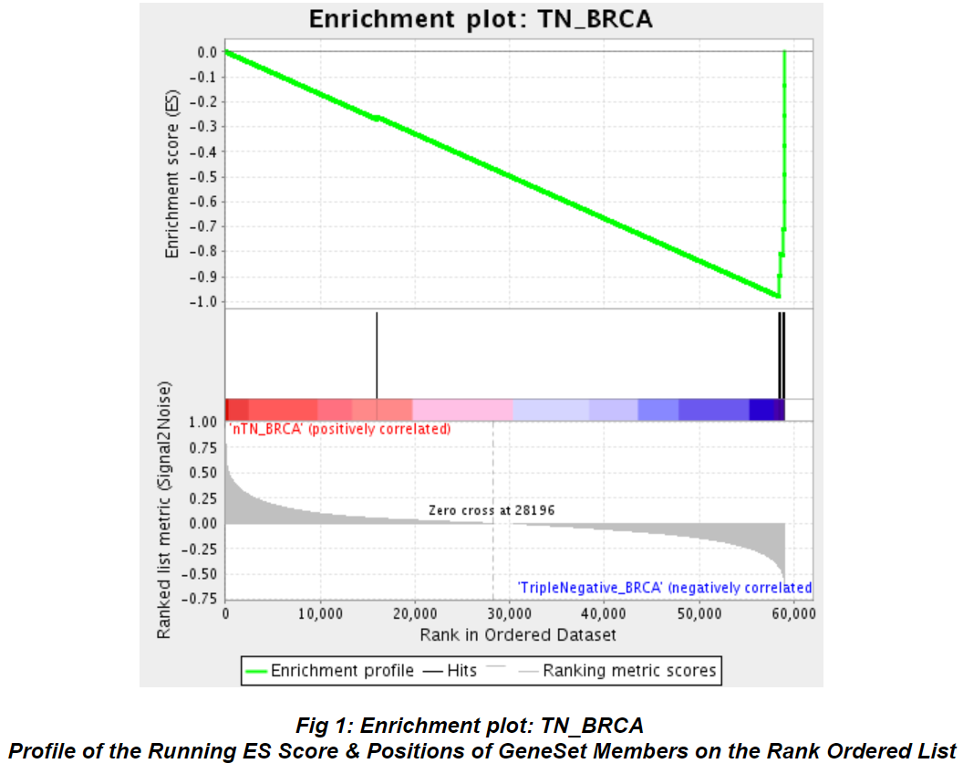
The Leading Edge Plot
Shows in which phenotype a gene set is enriched
Ideally we would see a clear peak in one of the phenotypes

Slide 9
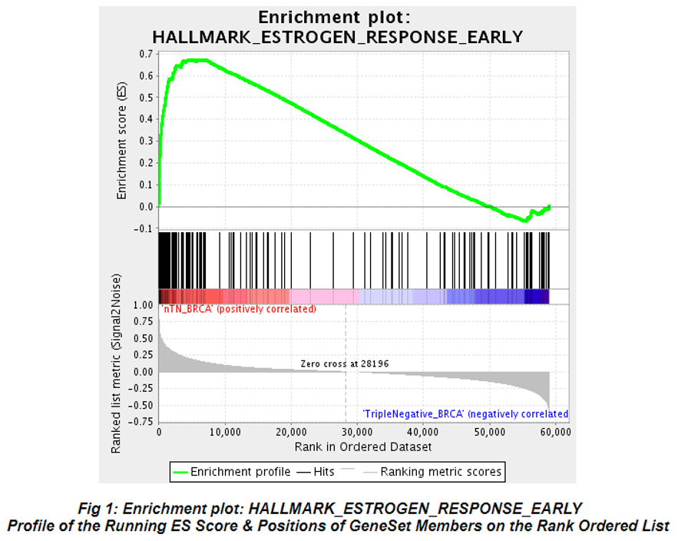
The Leading Edge Plot Continued
It is okay if we see a smaller peak in the other phenotype
Visualizes the enrichment score

Slide 10
The Gene Set Enrichment Score (ES)
Enriched Gene Set
Un-enriched Gene Set
Max. Enrichment Score ES
Max. Enrichment Score ES
Enrichment Score S
Enrichment Score S
Ranked list of genes
Ranked list of genes
Every hit adds a bit to the score (1/NH)
Every miss subtracts a bit from the score (1/NM)
Enrichment Score (ES) = maximum height
The size of the step depends on correlation
=> hits near the middle get smaller steps
Notes:
The primary result of the gene set enrichment analysis is the enrichment score (ES), which reflects the degree to which a gene set is overrepresented at the top or bottom of a ranked list of genes. GSEA calculates the ES by walking down the ranked list of genes, increasing a running-sum statistic when a gene is in the gene set and decreasing it when it is not. The magnitude of the increment depends on the correlation of the gene with the phenotype. The ES is the maximum deviation from zero encountered in walking the list. A positive ES indicates gene set enrichment at the top of the ranked list; a negative ES indicates gene set enrichment at the bottom of the ranked list.
One starts by defining the ordered gene list obtained by using any gene marker selection method and the selection of genes to include in a gene set. We define empirical cumulative distribution functions Phit and Pmiss to represent the fraction of gene set G genes that are present (“hits”) or absent (“misses”) in the ordered gene list up to a given position.
The size of the step is a function of the correlation. So early hits get larger steps than hits to the middle of the gene list.
The maximum deflection of the mountain plot is defined as the enrichment scoe (ES).
MOUNTAIN PLOT
p = 0 Classic Kolmogorov-Smirnov (no weighting)
p = 1 Use gene correlation as weight (standard weighting)

Slide 11
What if I only have few samples? Or if I want to project my data onto the pathway space? Single Sample GSEA (“projection”)

Slide 12
Single-Sample GSEA (ssGSEA)
Projects gene expression onto pathways
Dataset becomes pathways x samples
Works on one sample at a time
Any gene set can be used as a pathway
Does not require predefined classes

Slide 13
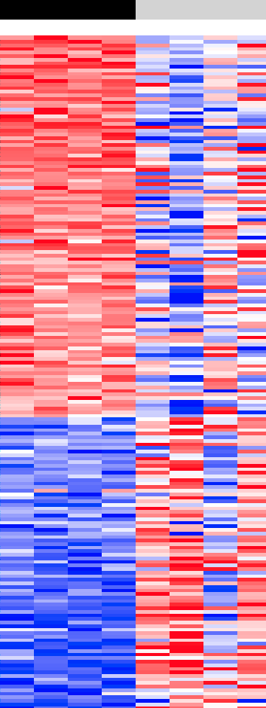
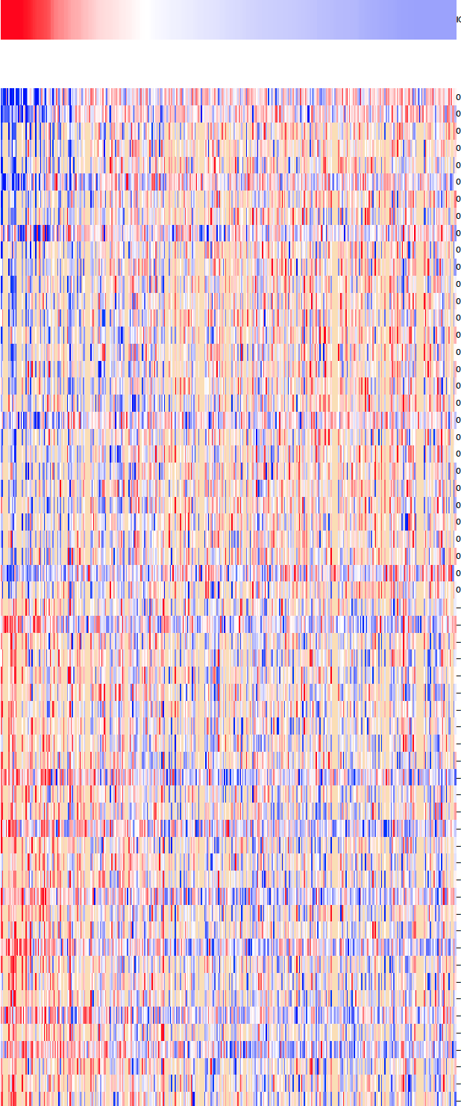
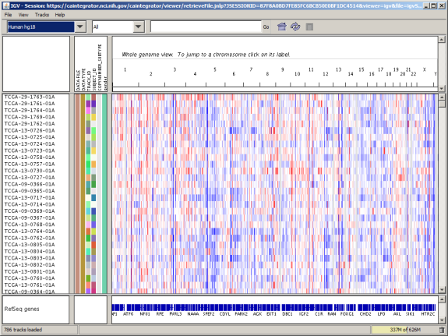
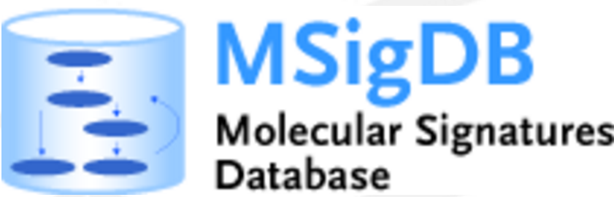
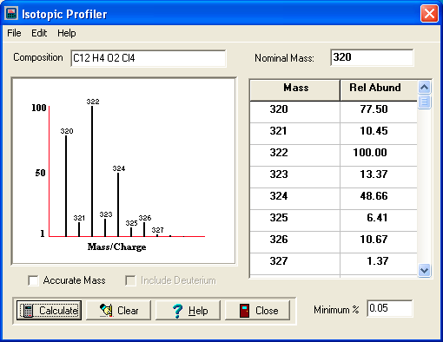

Different Modalities of GSEA
More details in : http://software.broadinstitute.org/gsea or msigdb.org
Standard GSEA
Single-Sample
GSEA
Pre-Ranked GSEA
RIGER
RNASeq
GSEA
Protein
GSEA
Gene Set
Overlap
Expression Dataset & Phenotype
Expression Dataset & Phenotype
Pre-ranked Profile
RNAi or CRISPR/Cas9 Dataset & Phenotype
RNASeq Files & phenotype
MS output Files & phenotype
2 Gene Sets
Gene Sets
Gene Sets
Gene Sets
hairpin or sgRNA-to gene library
Gene Sets
Protein Sets
Gene Ranking
Gene Sorting
GSEA
Enrichment
(Information-Theoretic )
Hairpin/sgRNA Ranking
RNASeq Pipeline
MS files Pipeline
GSEA
Enrichment
(Information-Theoretic )
Sample permutation test loop
Loop over
samples
Sample
permutation test loop
Gene Ranking
Protein Ranking
Gene permutation test loop
GSEA
Enrichment
(Information-Theoretic )
Statistics
GSEA
Enrichment
(Information-Theoretic )
GSEA
Enrichment
(Information-Theoretic )
Sample permutation test loop
Sample permutation test loop
Statistics
Report and Plots
Gene Ranking
Report and Plots
GSEA
Enrichment
(Information-Theoretic )
GSEA
Enrichment
(Information-Theoretic )
Statistics
Statistics
Report and Plots
Sample permutation
test loop
Report and Plots
Statistics
Statistics
Statistics
Report and Plots
Report and Plots
Report and Plots
Notes:
There are many different ways that GSEA can be used…

Slide 14
ssGSEA Exercise
2019-04-16_04 BioITWorld ssGSEA
Notes:
Remove

